Slide 1

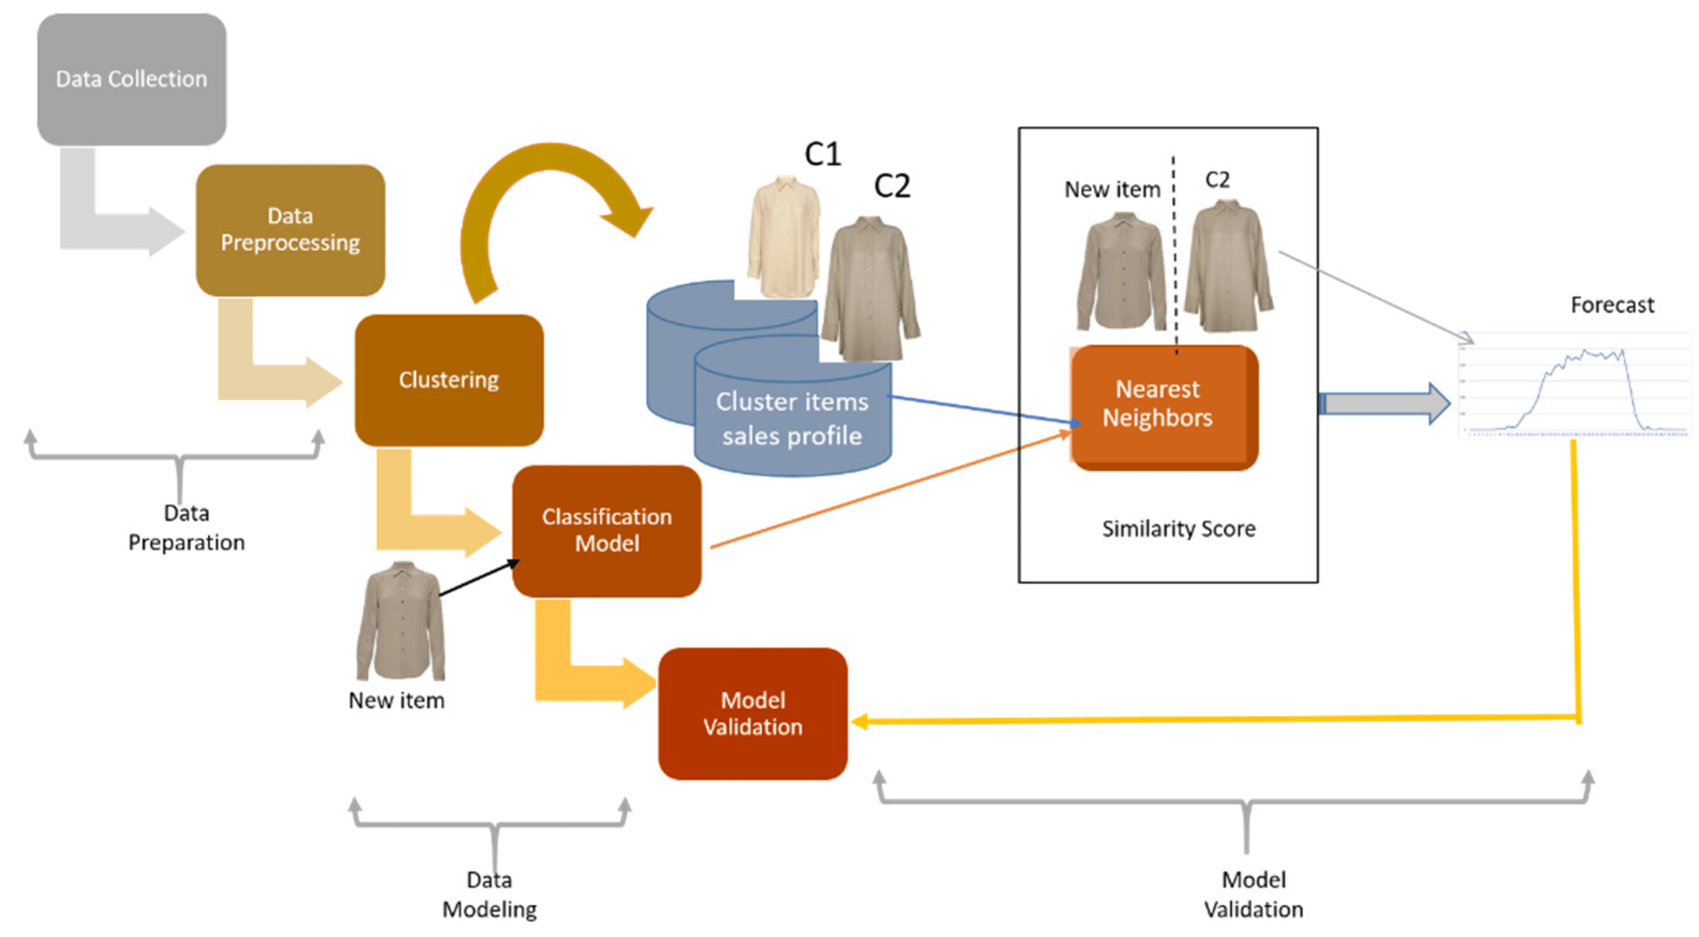
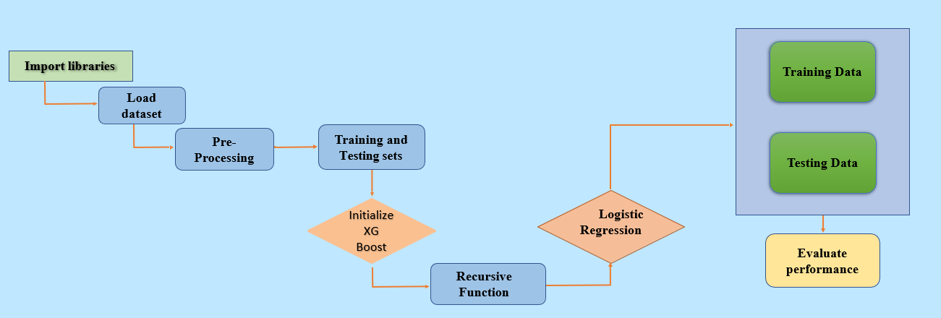
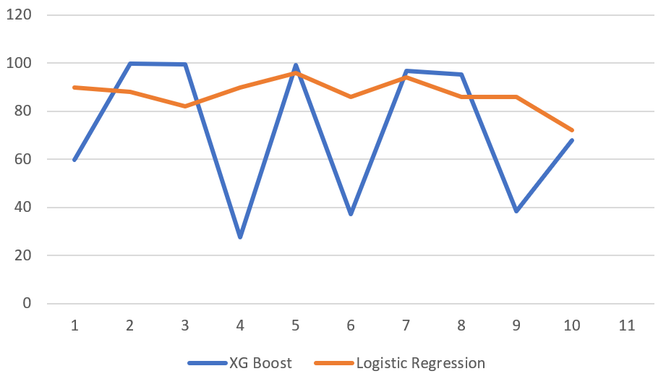
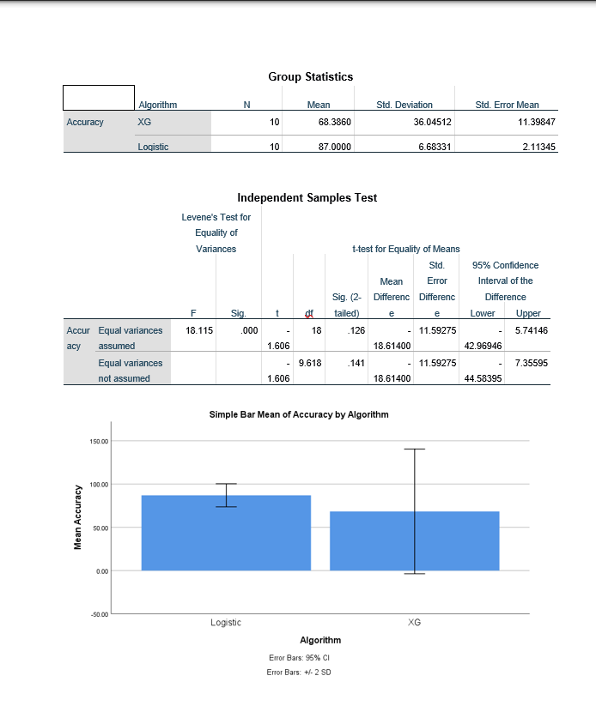
Name : S.Ashish Kumar
Register Number:192124142
Guided By : Dr .A.Muniyappan
Machine Learning Model Selection for Textile Production Prediction: A Comparative Investigation of XG Boost and Logistic Regression
INTRODUCTION
Overview of machine learning as a transformative force in various industrial domains, including textiles.
Focus on predictive modeling capabilities of machine learning in revolutionizing textile production processes.
Motivation behind the research: enhancing predictive capabilities in textile production.
Comparative investigation between XGBoost and Logistic Regression as prominent machine learning models.
This study delves into the realm of textile production prediction, aiming to discern the most effective machine learning approach.
Two groups were analyzed in this research.
Group 1: XGBoost Algorithm,
Group 2: Logistic Regression Algorithm.
This study delves into the realm of textile production prediction, aiming to discern the most effective machine learning approach.
The successful implementation of an optimal machine learning model in textile production prediction holds the potential to revolutionize industry practices.
Predicting Textile production
MATERIALS AND METHODS
RESULTS
Algorithm statistics of XG Boost And Logistic Regression
 | Group | N | Mean | Std. Deviation | Std. Error Mean
Accuracy | RANDOM FOREST | 10 | 61.18 | 30.15544 | 9.53599
 | XG BOOST | 10 | 63.38 | 36.0354 | 11.39847
First Accuracy Graph
XG Boost vs Logistic Regression
Based on the evaluation of Textile production, the Independent sample T-test obtained from Statistical package of social science (SPSS) software the threshold value p = 0.128 (Logistic regression vs XG Boost)
DISCUSSION AND CONCLUSION
Logistic Regression demonstrates superior accuracy (87.00%) compared to XG Boost (68.38%) in detecting textile production network intrusions, indicating its effectiveness in handling categorical data and binary classification tasks common in network security analysis.
The discrepancy in accuracy underscores the importance of understanding the specific factors contributing to performance differences between the two algorithms, highlighting the need for meticulous feature selection and model tuning processes.
The implications of these findings for the textile industry are noteworthy. Accurate prediction of production outcomes is crucial for optimizing resource allocation, minimizing waste, and improving overall efficiency in manufacturing processes.
Tailoring machine learning algorithms to the unique characteristics of textile production systems is essential, with logistic regression emerging as a promising choice due to its simplicity and interpretability in this context.
We used SPSS a data analysis of software made by IBM to perform analyzing on data obtained graph for both algorithms XG Boost and Logistic Regression.
T-test Statistical analysis reveals a significance value of p=0.001 (independent sample T-test p<0.05), signifying a statistically significant difference between the two groups.
Collaborative efforts between data scientists, network security experts, and textile industry professionals are crucial for developing robust intrusion detection systems that effectively safeguard production processes while minimizing false positives and negatives.
BIBLIOGRAPHY
Bohanec M, Borštnar MK, Robnik-Šikonja M (2017) Explaining machine learning models in sales predictions. Expert Syst Appl 71:416–428.
Chase CW Jr (2016) Machine learning is changing demand forecasting. J Bus Forecast 35(4):43.
Ampazis N (2015) Forecasting demand in supply chain using machine learning algorithms. Int J Artif Life Res (IJALR) 5(1):56–73.
Smolak K, Kasieczka B, Fialkiewicz W, Rohm W, Siła-Nowicka K, Kopańczyk K (2020) Applying human mobility and water consumption data for short-term water demand forecasting using classical and machine learning models. Urban Water J 17(1):32–42.
Sillanpää V, Liesiö J (2018) Forecasting replenishment orders in retail: value of modelling low and intermittent consumer demand with distributions. Int J Prod Res 56(12):4168–4185
Mohammed A (2020) Towards ‘gresilient’ supply chain management: a quantitative study. Resour Conserv Recycl 155:104641.
Oliva R, Watson N (2009) Managing functional biases in organizational forecasts: a case study of consensus forecasting in supply chain planning. Prod Oper Manag 18(2):138–151.
Kantasa-Ard A, Nouiri M, Bekrar A, Ait el Cadi A, Sallez Y (2021) Machine learning for demand forecasting in the physical internet: a case study of agricultural products in Thailand. Int J Prod Res 59(24):7491–7515.
Holzinger A (2016) Interactive machine learning for health informatics: when do we need the human-in-the-loop? Brain Inf 3(2):119–131.
Goecks J, Jalili V, Heiser LM, Gray JW (2020) How machine learning will transform biomedicine. Cell 181(1):92–101.

